Slide 1

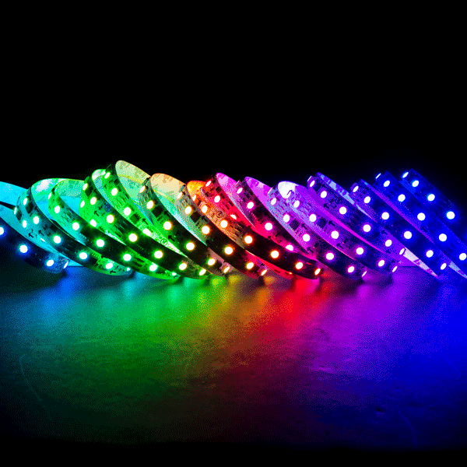
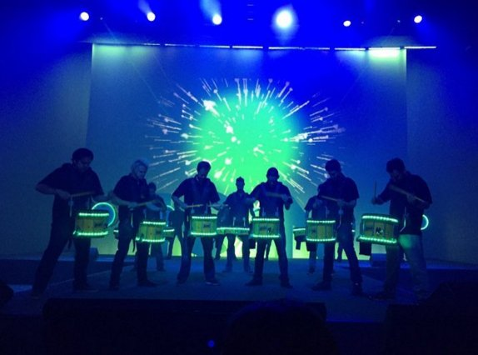
Drumline Lighting Effects - Connor Densmore -
The drumline lighting effects project will allow for us to attach RGB LED lights to drums of a drumline and cause them to change colors depending on certain aspects in the show. It add a lot of affect to the overall showing of the performance.

